Slide 1

Random Forest

Slide 2
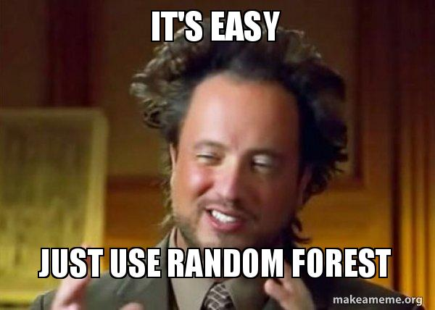
Previously, we’ve learned about Decision Trees – the basis of a whole new group of powerful new Machine Learning models for tabular data regression/classification tasks.
Now, we’re going combine several Decision Trees to build what we call a Random Forest

Slide 3

One of the fundamental ideas of Random Forest is to rely on majority voting. Why rely on one export’s opinion, when the majority is (on average) more likely to be correct?
Let’s see how this works!

Slide 4
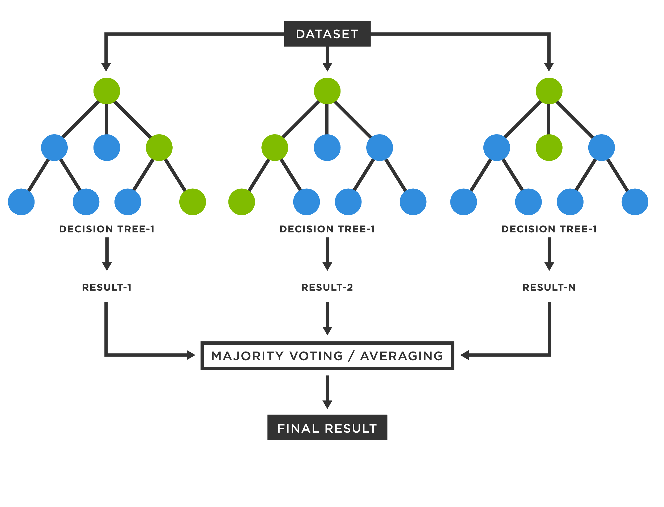

1. We begin by training n independent decision trees, using our training data.
Training data
…

Slide 5
2. Each one of these n trees produces an output.
The combined output of trees is the average of each of their independent outputs.
Classification:
We predict the class the majority of the trees predict.
Regression:
We predict the average of all the individual tree’s predictions.
Regardless, that combined output will be the final output of the Random Forest.
Training data
…

Slide 6
3. Now, whenever we want to predict on a new, unseen sample – we simply let each tree does its own prediction on that sample.
At the end, we combine their predictions to obtain our final prediction.
New sample
…

Slide 7
Let’s get more into the details!

Slide 8
A fundamental problem with training many different trees on the same training data, is that they tend to produce… identical trees.
But what’s the point of majority voting/averaging if they’re all the same anyway?
It turns out that it’s not very useful.
We thus have a problem that we need to solve here.
Training data
…

Slide 9
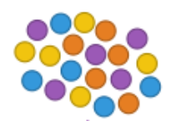



Training data
Bootstraping
Bootstraping is the process of dividing our training data into random subsets with replacement, one for each tree, and use those subsets to train respective tree.
Each tree is thus trained independently on random subsets of the data (with the possibility for overlap).
…
This combined technique of Bootstraping data and then averaging each individual models output is called Bagging.
Bagging: Bootstrap + Aggregation

Slide 10
But wait, there’s more!

Slide 11




Training data
To infuse even more diversity in our trees, and make them great at slightly different things, we can limit the the different trees see.
So in essence, we can, for each tree, pick out random subsets of the features that each tree have access to!
…

Slide 12
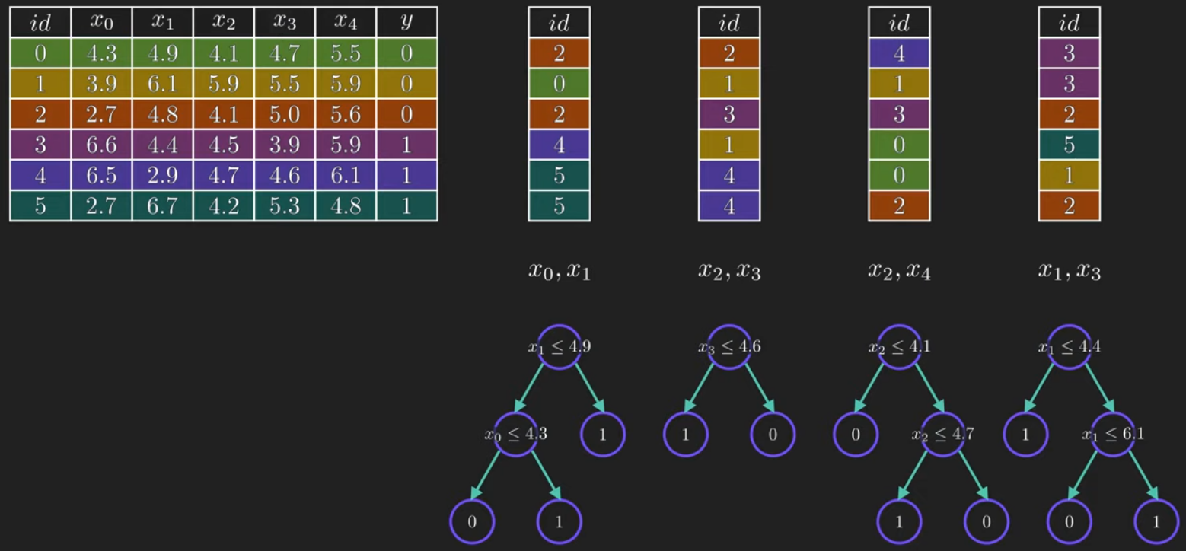
Visualization of Bootstraping and feature limitation, for each tree

Slide 13
Advantages of Random Forest
1. Ability to learn non-linear decision boundary
Random Forest is an ensemble learning algorithm that uses multiple decision trees to make predictions. It can model complex, non-linear relationships between features and the target variable
2. High performance
By utilizing many trees, it reduces the overfitting problem and helps to improve overall accuracy. It reduces prediction variance compared to single decision tree
3. Scalability
Random forest can handle large datasets with high dimensionality, making it a popular choice in many industries.
4. Feature importance
Random forest provides information about the importance of each feature in the data, which can be very helpful in understanding the underlying patterns.
You’ll work with feature importance in the lab

Slide 15

The “No Free Lunch” Theorem argues that, without having substantive information about the modeling problem, there is no single model that will always do better than any other model

Slide 16
Hyperparameters

Slide 17

Previously, we learned that most models have parameters that are learned during training.
However, most models can take additional parameters – that are not learned during training, but are decided by you!

Slide 18
For Random Forest, we have many such parameters not learned during training.
For example:
The number of parallell decision trees
The allowed maximum depth of each
The number of parallell decision trees
2. The allowed maximum depth of each

Slide 19
For Random Forest, we have many such parameters not learned during training.
For example:
The number of parallell decision trees
The allowed maximum depth of each
Collectively, parameters that you the user decide and are not learned during training, are called Hyperparameters.
The number of parallell decision trees
2. The allowed maximum depth of each

Slide 20
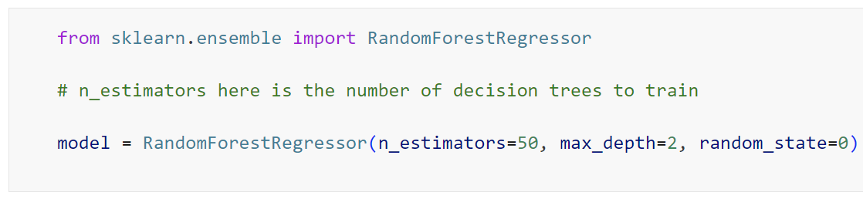
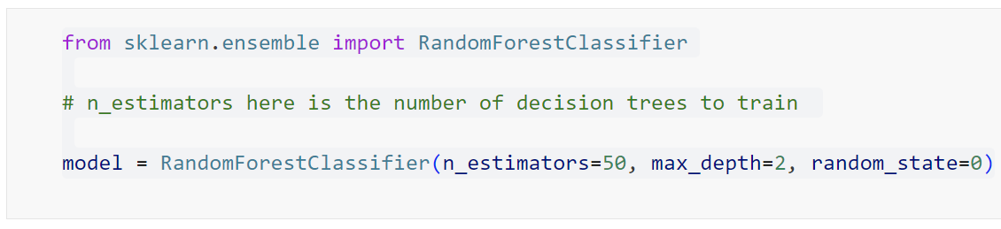
The crucial point is that choice of hyperparameters has a big effect on the performance of your model at the given classification/regression problem!
We therefore often have to test many different hyperparameters for any given model – to find the best performing ones.
Regression
Classification
We decide the model’s hyperparameters when we initialize the model

Slide 21
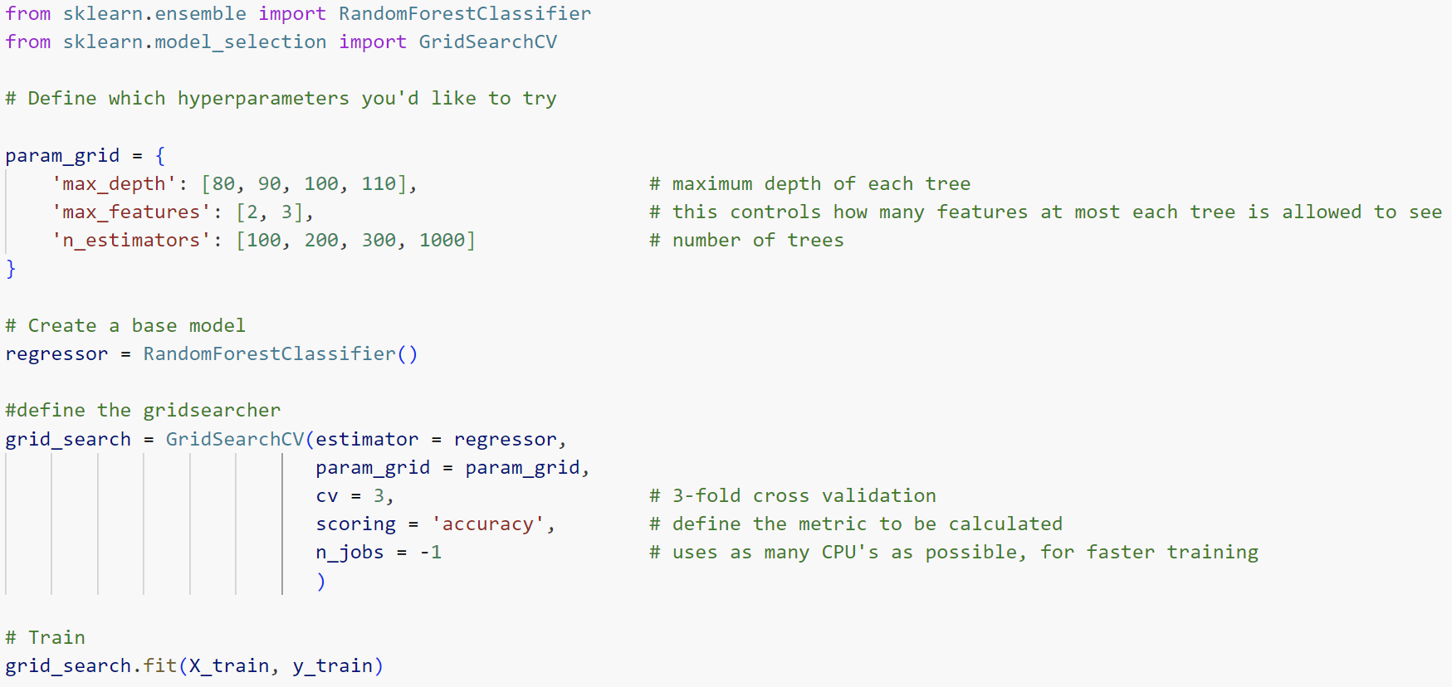
The good news is that we don’t manually have to test all hyperparameters – phew!
The process of finding the best performing hyperparameters is called Hyperperameter Tuning
All we have to do is to define which hyperparameters we want to try, sklearn then has a great function that cross-validates each possible combination

Slide 22
Ensamble Learning

Slide 23
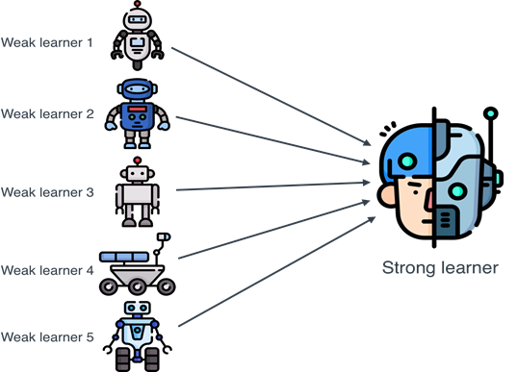
Random Forest is a combination of many independent Decision Trees, as we’ve seen.
This strategy, to combine the output of many models into a single output, is called Ensamble Learning.
The important point is that the different models you combine don’t all have to be the of the same type! You can combine whichever models you like.
This is a very powerful technique. Remember it for the future.

Slide 24
If you want even more!

Slide 25
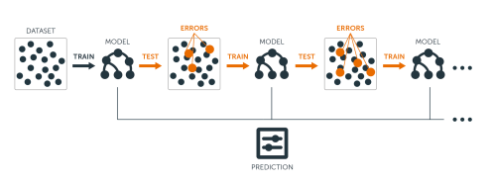
We’ve now learned about Random Forest and the Bagging method it uses.
There is another method, called Boosting. Try finding materials to read more about boosting.
Another tree-based model called XGBoost (probably the most famous, alongside Random Forest) is based on boosting. Adaboost is another.
You can ofcourse use these models without understanding boosting, but I really recommend reading about it to further your understanding.

